Slide 1
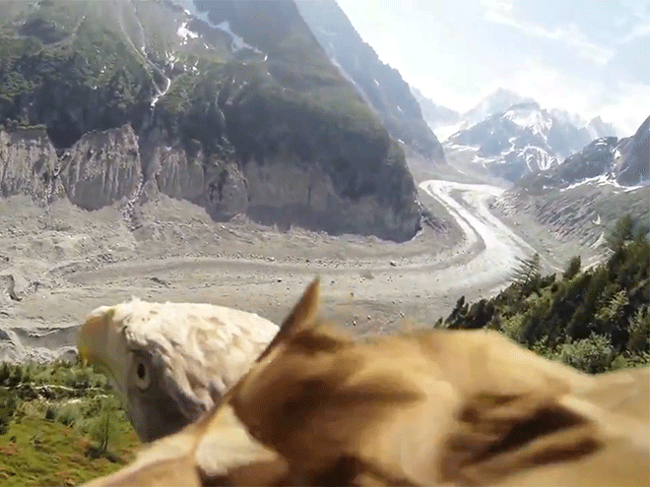
Lessons from
God’s Creatures pt. 2 & 3

Slide 2
Note: After you download the slideshow, you may also need to download some videos from YouTube & add them into this PowerPoint. This tool can help you: Free YouTube Download
We present these messages in outdoor venues using the SonShineTent. Watch the video of our service that goes with this message, click here: http://campaignkerusso.org/?p=13935
We would love to know more about the people who download our lessons & sermons. We invite you to email us & let us know where & how you use them.
info@campaignkerusso.org

Slide 3
Welcome All

Slide 4
Let’s Begin with Prayer

Slide 5
Lessons from
God’s Creatures pt. 2

Slide 6
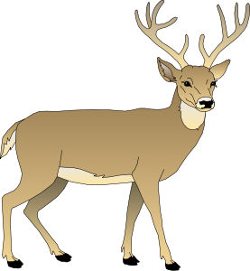
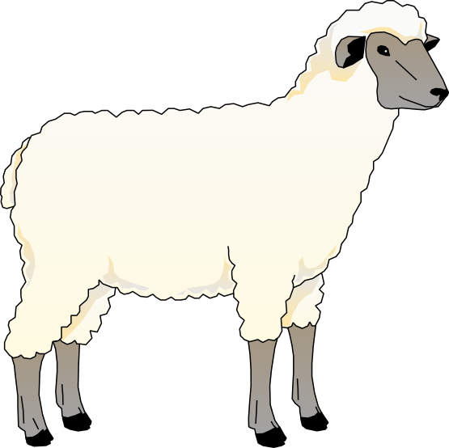
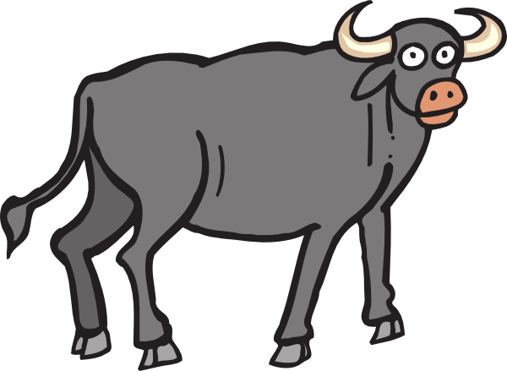
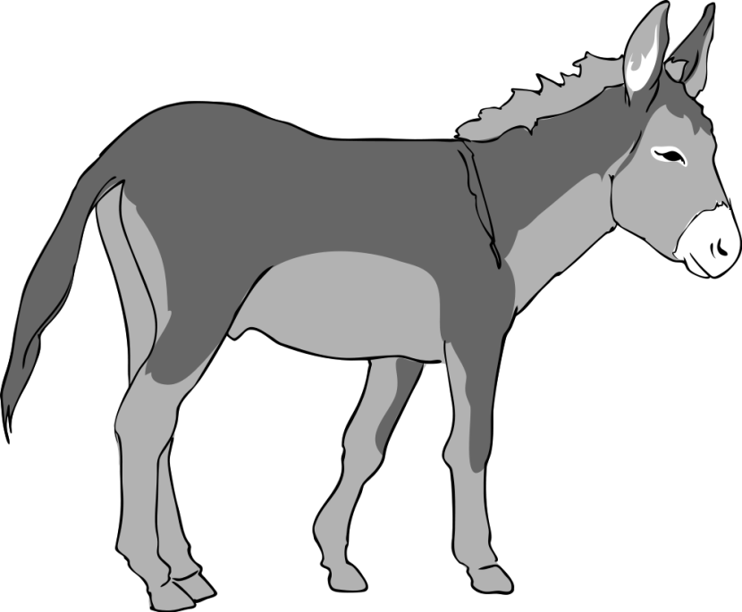
Previously…Part 1:
Lessons From Large Mammals

Slide 7
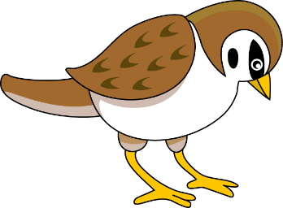
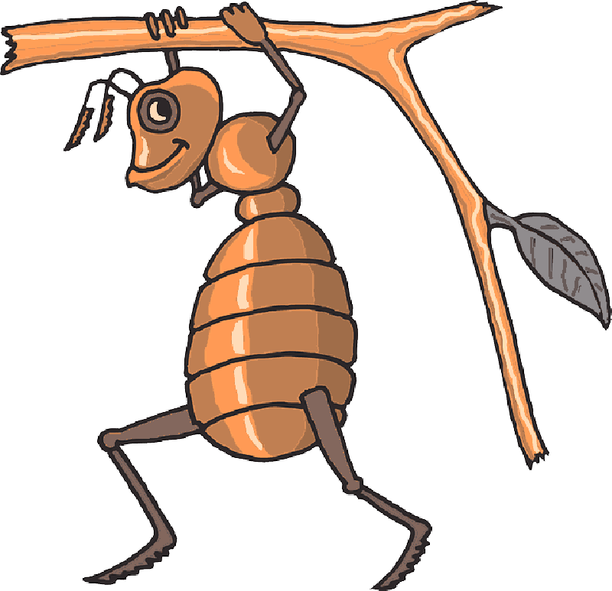
Part 2: Lessons From Birds & Bugs

Slide 8
Little Birds: God Meets Their Needs
“Look at the birds! They don’t worry about what to eat—they don’t need to sow or reap or store up food—for your heavenly Father feeds them. And you are far more valuable to him than they are.” Matt 6:25-27 TLB

Slide 9
Sparrow Questions
What do birds worry about?
How do birds grow & store food?
How do they get fed?
Who’all, in God’s mind, are even more important than little birds?
How do we know God will watch over us?

Slide 10
Video: Caring for a Fallen Sparrow
Video Goes Here Title: His Eye is on the Sparrow Download Here:
https://youtu.be/tRI8Jnml0tE

Slide 11
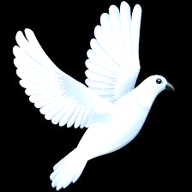
Doves are Gentle & Very Kind
“Listen! I am sending you, and you will be like sheep among wolves. So be smart like snakes. But also be like doves and don’t hurt anyone.”
Mat. 10:16 ERV

Slide 12
Why Sheep also need to be like Snakes & Doves
What happens to a little sheep in the middle of a pack of wolves?
How are believers (living in an unbelieving world) like sheep among wolves?
How can believers be wise as they relate to unbelievers in this world?
How can believers be more like doves (and more like like Jesus)?

Slide 13
If Only We Were All As Gentle Doves
Video Goes Here Title: Corgi, cat, rat and dove Download Here:
https://www.youtube.com/watch?v=07TNZiWeysk

Slide 14
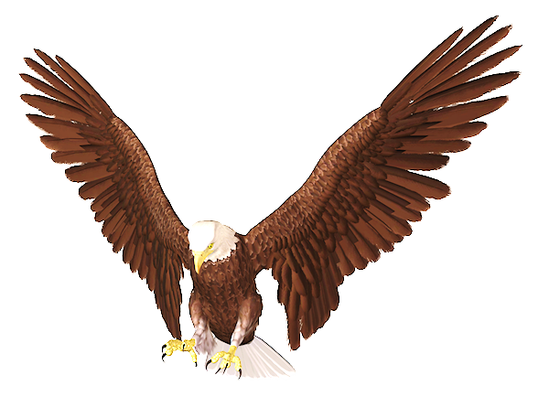
Eagles fly above it all and are forever renewed.
“But those who trust in the Lord will become strong again. They will be like eagles that grow
new feathers. They will run and not get weak. They will walk and not get tired.” Isa. 40:31 ERV

Slide 15
Eagle Questions
What happens to tired eagles who have lost some feathers?
Who will also be renewed?
What will happen when they run & walk?

Slide 16
God Gives Us An Eagle’s Viewpoint–Far Above Worldly Concerns
Video Goes Here Title: Eagle’s Viewpoint Download Here:
https://youtu.be/gwnr4LMNA2I

Slide 17
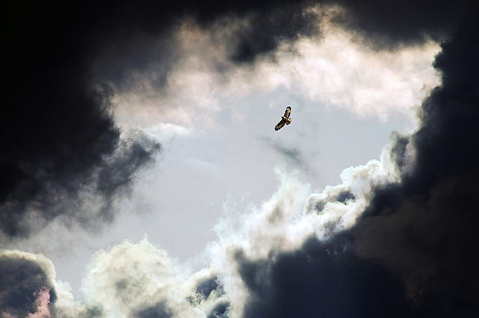
An eagle uses the storm to lift him up above the clouds.

Slide 18
More Eagle Questions
What is it like when a believer has an eagle’s viewpoint (above worldly concerns)?
How can believers use life’s troubles as eagles use storms?

Slide 19
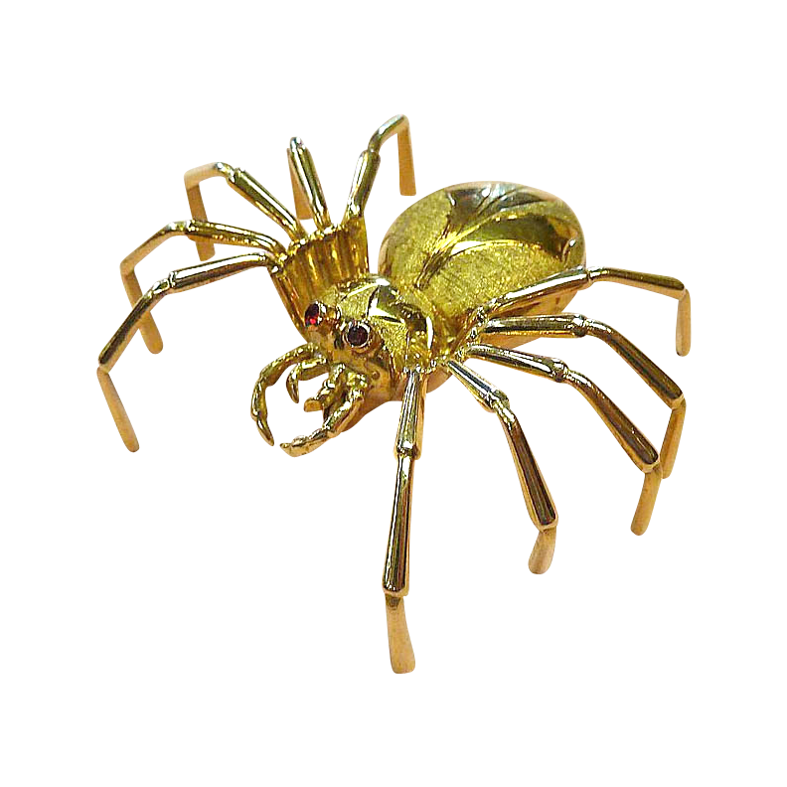
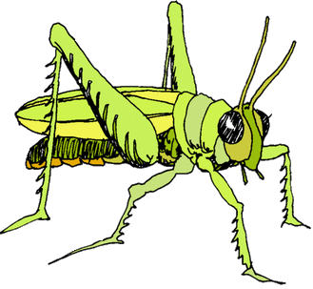
Lessons From Bugs

Slide 20
Video: Ants Work Hard
Video Goes Here Title: How Much Do Ants Work? Download Here:
https://www.youtube.com/watch?v=ZQUgb4m7Fgw

Slide 21
Ants Aren’t Afraid of Hard Work
“You people who don’t want to work, think about the ant! Consider its ways and be wise!” Prov. 6:6 NIRV

Slide 22
Ant Questions
Who works harder—ants or people?
What does the bible say we should think about when we watch ants?
How can we be wise?

Slide 23
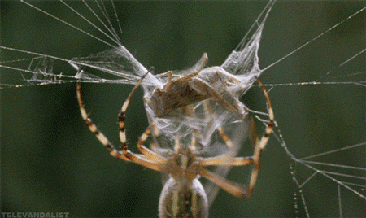
“The spider (or lizard) taketh hold with her hands, and is in kings' palaces.”
Prov. 30:28 KJV

Slide 24
Spiders (& Lizards) Grab Hold and Hang on Tight
A Spider Hangs On
A Lizard Hangs On

Slide 25
“Be ye strong, therefore, and do not let your hands be weak, for your work shall be rewarded.” 2 Chron. 15:7

Slide 26
Spider Questions
What does a spider do with her hands?
When does she let go of her project?
Where might her determination get her?
What will happen if a believer never let’s go?

Slide 27
Locusts Work Together As Equals
“Locusts have no king, but march like an army” Pv. 30:27 CEV

Slide 28
Video: Locusts on a Mission
Video Goes Here: Title: Plagues of Locusts Download Here:
https://www.youtube.com/watch?v=1YNy2R3hg2Q

Slide 29
“Is Apollos so important? Is Paul so important? We are only servants of God who helped you believe. Each one of us did the work God gave us to do.”
1 Cor. 3:5 ERV

Slide 30
Locust Questions
What important position do locusts manage to do without?
Is any one locust more important than the others?
How effectively do locusts do their work?
Why are the bugs so effective?
What did Paul say about himself and another preacher named Apollos?
What must each one of us do?

Slide 31
Questions about Birds & Bugs
When it comes to work, what is the difference between God’s little birds and His busy bugs?
Food for thought:
Are we to work hard or just trust God?

Slide 32
Is Jesus
Speaking to You?
“They said to each other, ‘Did not our hearts burn within us while he talked to us on the road, while he opened to us the Scriptures?’”
John Wesley Said:
“…the preacher was describing the change which God works in the heart through faith in Christ and I felt my heart strangely warmed.”
Jesus makes His presence Known by a small voice!

Slide 34
What is the Sinner‘s Prayer?
This is a prayer we can pray when we are ready to admit we are sinners and need Christ’s forgiveness.
It must be prayed with faith in our hearts and a readiness to have a life-changing encounter with Jesus Christ.

Slide 35
A prayer of faith → Pray this prayer if :
If you never have before
You have in the past, but you think it would mean more today
You have been walking afar off and you want to come back
You want to set an example & show others how it is done
You just like to give your heart to Jesus again & again
Faith

Slide 36
We Declare Our Faith Publicly Because Jesus Declared His LOVE Publicly
“If you stand before others and are willing to say you believe in me, then I will tell my Father in heaven that you belong to me.” Mat 10:32

Slide 37
Three Important Questions
Do you want to know Jesus as your Savior right now?
Do you believe He died to save you from your sins & that He rose from the dead?
Do you believe that He is here, waiting to save you right now?

Slide 38
The Prayer of a Sinner Turning to Jesus
Dear Jesus, I know that I have sinned against You and that my sins separate me from You.
I am truly sorry.
Right now, I turn away from my sinful past .
Please forgive me, and help me to keep from sin.
I believe You died for my sins.
I Believe You rose from the dead, you are alive, and you hear this prayer from my heart.
I invite You Jesus to be both my Savior and the Lord of my life.
I want You to rule my life from now on.

Slide 39
“But some people did accept him. They believed in him, and he gave them the right to become children of God.”
John 1:12

Slide 41
“If you openly say, ‘Jesus is Lord’ and believe in your heart that God raised him from death, you will be saved.”
Rom. 10:9
What did you learn today?
What about God’s Birds & Bugs?
What have you been thinking about God lately?
What do you want to tell others about Jesus?

Slide 42
Let’s Close in Prayer

Slide 43
Note: After you download the slideshow, you may also need to download some videos from YouTube & add them into this PowerPoint. This tool can help you: Free YouTube Download
We present these messages in outdoor venues using the SonShineTent. Watch the video of our service that goes with this message, click here: http://campaignkerusso.org/?p=13935
We would love to know more about the people who download our lessons & sermons. We invite you to email us & let us know where & how you use them.
info@campaignkerusso.org

